Slide 1

Systematic Trading Education Certificate Lecture 3

Slide 2
Outline of the STEC
Session 1 Introduction - 5th March
Introduction to systematic trading and financial basics
Momentum strategies including relative and cross sectional momentum
Session 2 Mean Reversion - 12th March
Mean reversion strategies and Fibonacci strategies
Value strategies
Session 3 – 19th March
ML models
Sentiment analysis

Slide 3
Intro to Machine Learning
Ben Dent
Software Engineer, BlackRock
Imperial Department of Computing ‘21

Slide 4
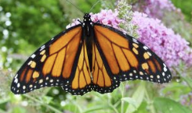
Classification
Classifier
Butterfly
f(
) = y
y is discrete or categorical

Slide 5
Classification
Regressor
0.4682
f(
) = y
y is real valued or continuous

Slide 6
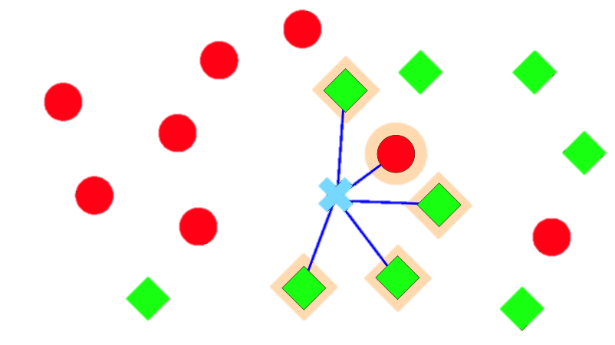
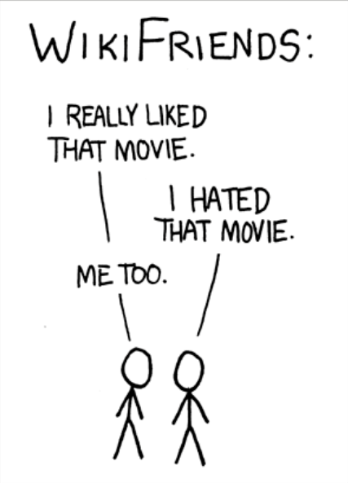
k-Nearest Neighbours – Regression or Classification

Slide 7
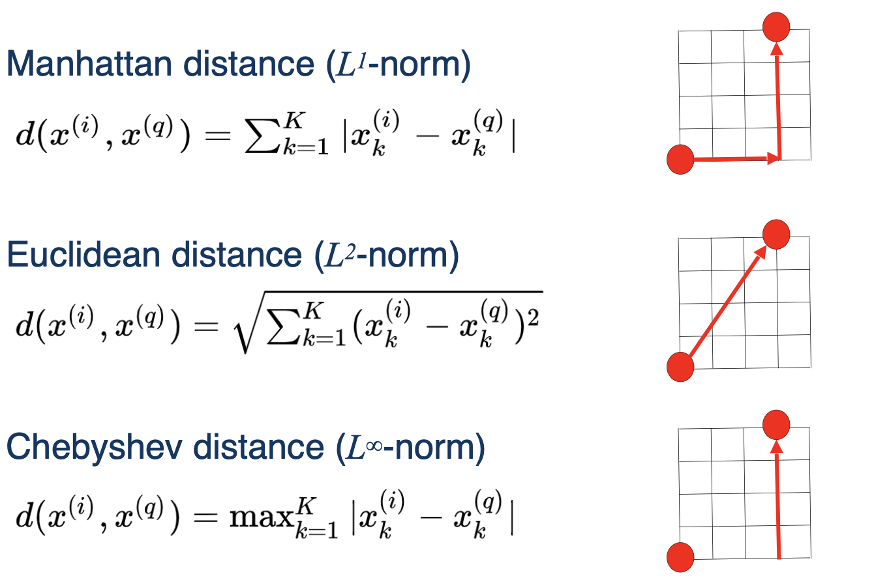
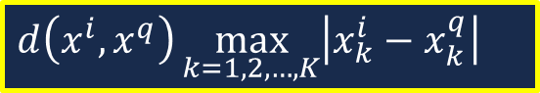
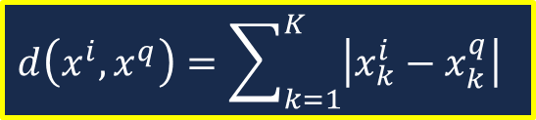
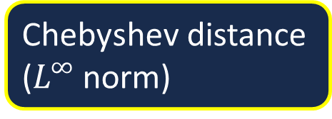
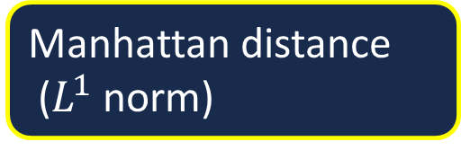
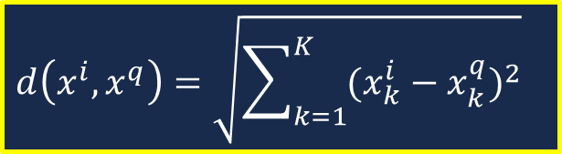
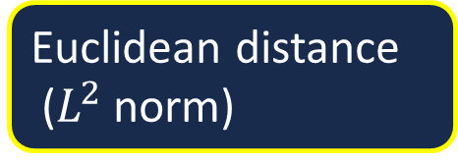
k-Nearest Neighbours – Distance function
Manhattan distance
($L^{1}$ norm)
Euclidean distance
($L^{2}$ norm)
Chebyshev distance
($L^{∞}$ norm)
$$d\left(x^{i},x^{q}\right)=\sum_{k=1}^{K}{\left|x_{k}^{i}−x_{k}^{q}\right|}$$
$$d\left(x^{i},x^{q}\right)=\sqrt{\sum_{k=1}^{K}{{(x_{k}^{i}−x_{k}^{q})}^{2}}}$$
$$d\left(x^{i},x^{q}\right)\max_{k=1,2,…,K}\left|x_{k}^{i}−x_{k}^{q}\right|$$

Slide 8
k-Nearest Neighbours – Example (k=3)
Number of Stripes | Number of Points | Liked by Me
1 | 3 | N
5 | 3 | Y
2 | 5 | N
6 | 2 | Y
3 | 6 | N
7 | 1 | Y
4 | 4 | N
8 | 2 | Y
Number of Stripes | Number of Points | Liked by Me
6 | 4 | ?

Slide 9
k-Nearest Neighbours – Example (k=3)
Number of Stripes (Data) | Number of Points (Data) | Liked by Me | Number of Stripes (New) | Number of Points (New) | Distance (3dp)
1 | 3 | N | 6 | 4 | 5.099
5 | 3 | Y | 6 | 4 | 1.414
2 | 5 | N | 6 | 4 | 4.123
6 | 2 | Y | 6 | 4 | 2
3 | 6 | N | 6 | 4 | 3.606
7 | 1 | Y | 6 | 4 | 3.162
4 | 4 | N | 6 | 4 | 2
8 | 2 | Y | 6 | 4 | 2.838
Liked by Me | Num closest
Y | 2
N | 1

Slide 10
k-Nearest Neighbours – Example (k=3)
Number of Stripes | Number of Points | Liked by Me
1 | 3 | N
5 | 3 | Y
2 | 5 | N
6 | 2 | Y
3 | 6 | N
7 | 1 | Y
4 | 4 | N
8 | 2 | Y
Number of Stripes | Number of Points | Liked by Me
6 | 4 | Y

Slide 11
k-Nearest Neighbours – Example (k=3) Weighted Distance
Number of Stripes (Data) | Number of Points (Data) | Liked by Me | Number of Stripes (New) | Number of Points (New) | Weighted Distance (1/d) (3dp)
1 | 3 | N | 6 | 4 | 0.196
5 | 3 | Y | 6 | 4 | 0.707
2 | 5 | N | 6 | 4 | 0.243
6 | 2 | Y | 6 | 4 | 0.5
3 | 6 | N | 6 | 4 | 0.277
7 | 1 | Y | 6 | 4 | 0.316
4 | 4 | N | 6 | 4 | 0.5
8 | 2 | Y | 6 | 4 | 0.354
Liked by Me | Sum of Weights (3dp)
Y | 1.877
N | 1.126

Slide 12
k-Nearest Neighbours – Example (k=3) - Aside
Number of Stripes | Number of Points | Liked by Me
1 | 3 | N
5 | 3 | Y
2 | 5 | N
6 | 2 | Y
3 | 6 | N
7 | 1 | Y
4 | 4 | N
8 | 2 | Y
Number of Stripes | Number of Points | Liked by Me
6 | 4 | Y

Slide 13
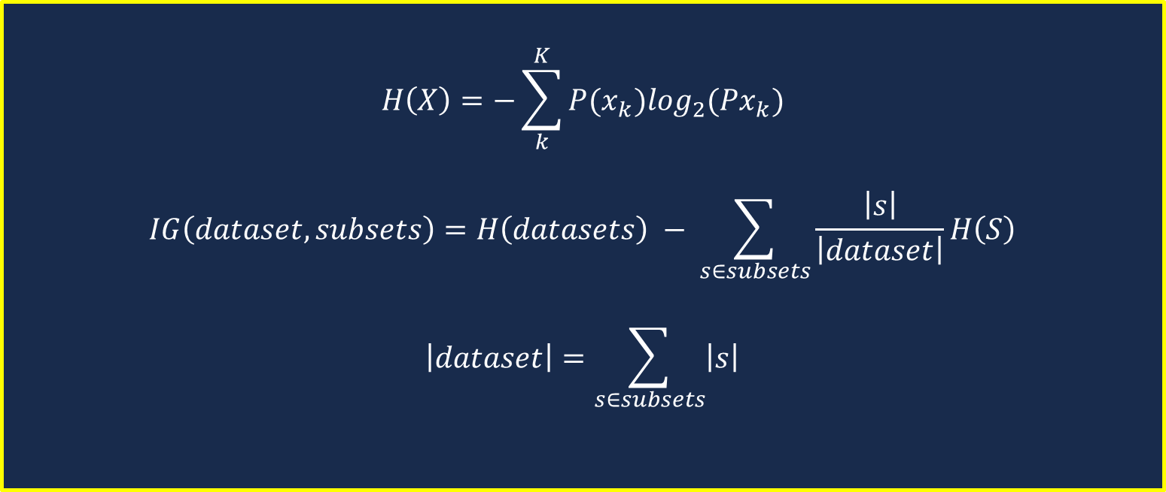
Information Gain - Formulae
$$H\left(X\right)=−\sum_{k}^{K}{P(x_{k})\log_{2}(Px_{k})}$$
$$IG\left(dataset, subsets\right)=H\left(datasets\right) − \sum_{s∈subsets}{\frac{\left|s\right|}{\left|dataset\right|}H\left(S\right)}$$
$$\left|dataset\right|=\sum_{s∈subsets}{\left|s\right|}$$

Slide 14
Decision Trees
playTennis(d) | outlook | temperature | humidity | wind
0 | sunny | hot | high | weak
0 | sunny | hot | high | strong
1 | overcast | hot | high | weak
1 | rain | mild | high | weak
1 | rain | cool | normal | weak
0 | rain | cool | normal | strong
1 | overcast | cool | normal | strong
0 | sunny | mild | high | weak
1 | sunny | cool | normal | weak
1 | rain | mild | normal | weak
1 | sunny | mild | normal | strong
1 | overcast | mild | high | strong
1 | overcast | hot | normal | weak
0 | rain | mild | high | strong

Slide 15

Decision Trees
playTennis(d) | outlook
0 | sunny
0 | sunny
1 | overcast
1 | rain
1 | rain
0 | rain
1 | overcast
0 | sunny
1 | sunny
1 | rain
1 | sunny
1 | overcast
1 | overcast
0 | rain
$$H\left(D\right)=−\frac{9}{14}\log_{2}\left(\frac{9}{14}\right)−\frac{5}{14}\log_{2}\left(\frac{5}{14}\right)=0.940$$
$$H\left(D_{hot}\right)=−\frac{2}{4}\log_{2}\left(\frac{2}{4}\right)−\frac{2}{4}\log_{2}\left(\frac{2}{4}\right)=1$$
$$H\left(D_{mild}\right)=−\frac{4}{6}\log_{2}\left(\frac{4}{6}\right)−\frac{2}{6}\log_{2}\left(\frac{2}{6}\right)=0.918$$
$$H\left(D_{cool}\right)=−\frac{3}{4}\log_{2}\left(\frac{3}{4}\right)−\frac{1}{4}\log_{2}\left(\frac{1}{4}\right)=0.811$$
$$IG\left(D_{temperature}\right)=H\left(D\right)−\left(\frac{4}{14}H\left(D_{hot}\right)+\frac{6}{14}H\left(D_{mild}\right)+\frac{4}{14}H\left(D_{cool}\right)\right)=0.029$$

Slide 16

Decision Trees
playTennis (d) | temperature
0 | hot
0 | hot
1 | hot
1 | mild
1 | cool
0 | cool
1 | cool
0 | mild
1 | cool
1 | mild
1 | mild
1 | mild
1 | hot
0 | mild
$$H\left(D\right)=−\frac{9}{14}\log_{2}\left(\frac{9}{14}\right)−\frac{5}{14}\log_{2}\left(\frac{5}{14}\right)=0.940$$
$$H\left(D_{sunny}\right)=−\frac{2}{5}\log_{2}\left(\frac{2}{5}\right)−\frac{3}{5}\log_{2}\left(\frac{3}{5}\right)=0.971$$
$$H\left(D_{overcast}\right)=−\frac{4}{4}\log_{2}\left(\frac{4}{4}\right)−\frac{0}{4}\log_{2}\left(\frac{0}{4}\right)=0$$
$$H\left(D_{rain}\right)=−\frac{3}{5}\log_{2}\left(\frac{3}{5}\right)−\frac{2}{5}\log_{2}\left(\frac{2}{5}\right)=0.971$$
$$IG\left(D_{outlook}\right)=H\left(D\right)−\left(\frac{5}{14}H\left(D_{sunny}\right)+\frac{4}{14}H\left(D_{overcast}\right)+\frac{5}{14}H\left(D_{rain}\right)\right)=0.246$$

Slide 17

Decision Trees
playTennis (d) | humidity
0 | high
0 | high
1 | high
1 | high
1 | normal
0 | normal
1 | normal
0 | high
1 | normal
1 | normal
1 | normal
1 | high
1 | normal
0 | high
$$H\left(D\right)=−\frac{9}{14}\log_{2}\left(\frac{9}{14}\right)−\frac{5}{14}\log_{2}\left(\frac{5}{14}\right)=0.940$$
$$H\left(D_{high}\right)=−\frac{3}{7}\log_{2}\left(\frac{3}{7}\right)−\frac{4}{7}\log_{2}\left(\frac{4}{7}\right)=0.985$$
$$H\left(D_{normal}\right)=−\frac{6}{7}\log_{2}\left(\frac{6}{7}\right)−\frac{1}{7}\log_{2}\left(\frac{1}{7}\right)=0.591$$
$$IG\left(D_{humitidy}\right)=H\left(D\right)−\left(\frac{7}{14}H\left(D_{high}\right)+\frac{7}{14}H\left(D_{normal}\right)\right)=0.151$$

Slide 18

Decision Trees
playTennis (d) | wind
0 | weak
0 | strong
1 | weak
1 | weak
1 | weak
0 | strong
1 | strong
0 | weak
1 | weak
1 | weak
1 | strong
1 | strong
1 | weak
0 | strong
$$H\left(D\right)=−\frac{9}{14}\log_{2}\left(\frac{9}{14}\right)−\frac{5}{14}\log_{2}\left(\frac{5}{14}\right)=0.940$$
$$H\left(D_{weak}\right)=−\frac{6}{8}\log_{2}\left(\frac{6}{8}\right)−\frac{2}{8}\log_{2}\left(\frac{2}{8}\right)=0.811$$
$$H\left(D_{strong}\right)=−\frac{3}{6}\log_{2}\left(\frac{3}{6}\right)−\frac{3}{6}\log_{2}\left(\frac{3}{6}\right)=1$$
$$IG\left(D_{wind}\right)=H\left(D\right)−\left(\frac{8}{14}H\left(D_{weak}\right)+\frac{6}{14}H\left(D_{strong}\right)\right)=0.048$$

Slide 19
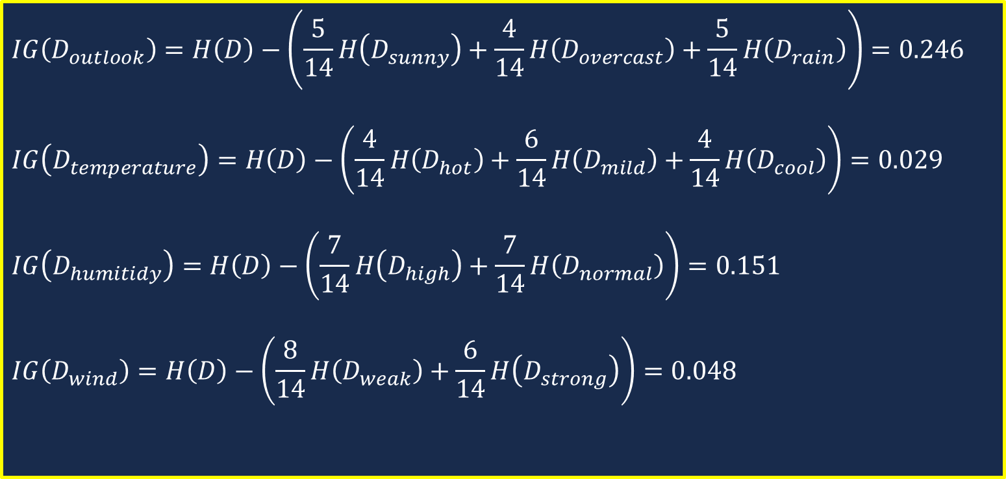
Decision Trees
$$IG\left(D_{outlook}\right)=H\left(D\right)−\left(\frac{5}{14}H\left(D_{sunny}\right)+\frac{4}{14}H\left(D_{overcast}\right)+\frac{5}{14}H\left(D_{rain}\right)\right)=0.246$$
$$IG\left(D_{temperature}\right)=H\left(D\right)−\left(\frac{4}{14}H\left(D_{hot}\right)+\frac{6}{14}H\left(D_{mild}\right)+\frac{4}{14}H\left(D_{cool}\right)\right)=0.029$$
$$IG\left(D_{humitidy}\right)=H\left(D\right)−\left(\frac{7}{14}H\left(D_{high}\right)+\frac{7}{14}H\left(D_{normal}\right)\right)=0.151$$
$$IG\left(D_{wind}\right)=H\left(D\right)−\left(\frac{8}{14}H\left(D_{weak}\right)+\frac{6}{14}H\left(D_{strong}\right)\right)=0.048$$

Slide 20
Decision Trees
Outlook
sunny
rain
overcast
D1
D3
Humidity
Wind
D2

Slide 21
Evaluation of Models

Slide 22

Evaluation of Models
Ensure to split into test / training data (or test / training /validation)
Cross-Validation
Divide dataset into k folds (usually 10)
k – 1 for training / validation and 1 for testing
Iterate k times
Take global error:
$$\frac{1}{N}\sum_{i=1}^{n}{e_{i}}$$

Slide 23
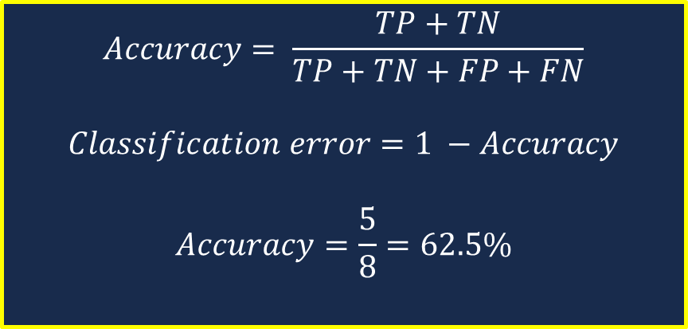
Evaluation Metrics - Accuracy
Number of correctly classified examples, divided by the total number of examples
Labels | Predictions
+ | +
+ | +
+ | -
+ | +
- | -
- | +
- | -
- | +
$$Accuracy= \frac{TP+TN}{TP+TN+FP+FN}$$
$$Classification error=1 −Accuracy$$
$$Accuracy=\frac{5}{8}=62.5\%$$
 | Class 1 Predicted | Class 2 Predicted
Class 1 Predicted | TP (True Positive): 3 | FN (False Negative): 1
Class 2 Predicted | FP (False Positive): 2 | TN (True Negative): 2

Slide 24
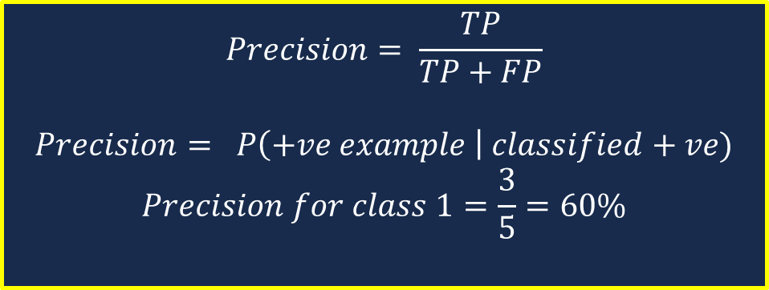
Evaluation Metrics - Precision
Number of correctly classified positive examples, divided by the total number of positive examples. High precision = low FP
Labels | Predictions
+ | +
+ | +
+ | -
+ | +
- | -
- | +
- | -
- | +
$$Precision= \frac{TP}{TP+FP}$$
$$Precision= P\left(+ve example \right| classified+ve)$$
$$Precision for class 1=\frac{3}{5}=60\%$$
 | Class 1 Predicted | Class 2 Predicted
Class 1 Predicted | TP (True Positive): 3 | FN (False Negative): 1
Class 2 Predicted | FP (False Positive): 2 | TN (True Negative): 2

Slide 25
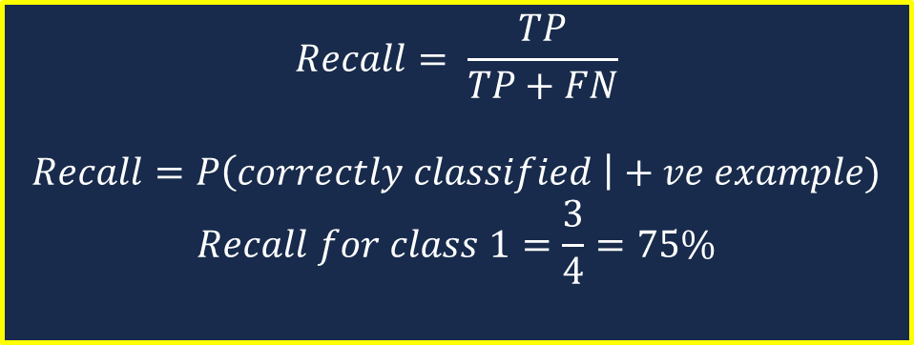
Evaluation Metrics - Recall
Number of correctly classified positive examples, divided by the total number of positive examples. High precision = low FP
Labels | Predictions
+ | +
+ | +
+ | -
+ | +
- | -
- | +
- | -
- | +
$$Recall= \frac{TP}{TP+FN}$$
$$Recall=P\left(correctly classified \right|+ve example)$$
$$Recall for class 1=\frac{3}{4}=75\%$$
 | Class 1 Predicted | Class 2 Predicted
Class 1 Predicted | TP (True Positive): 3 | FN (False Negative): 1
Class 2 Predicted | FP (False Positive): 2 | TN (True Negative): 2

Slide 26
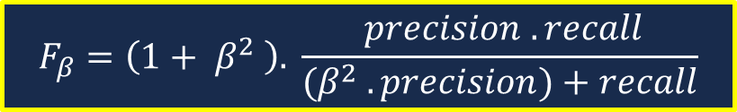

Evaluation Metrics – Precision vs Recall
High recall, low precision:
Low FN but many FP
Low recall, high precision:
High FN but low FP
Macro Averaged Recall
It is possible to average recall metrics across classes and this is done using the F measure or F-Score with formulae:
$$F_{1}= \frac{2 . precision . recall}{precision+recall}$$
$$F_{β}=\left(1+ β^{2} \right). \frac{ precision . recall}{(β^{2} . precision)+recall}$$

